Slide 1
Chapter 2
Basic Structures
Sets, Functions
Sequences, and Sums

Slide 2
Objectives
Sets
Set operations
Functions
Sequences
Summations

Slide 3
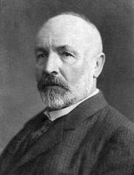
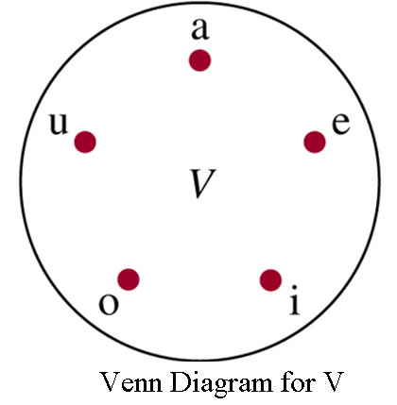
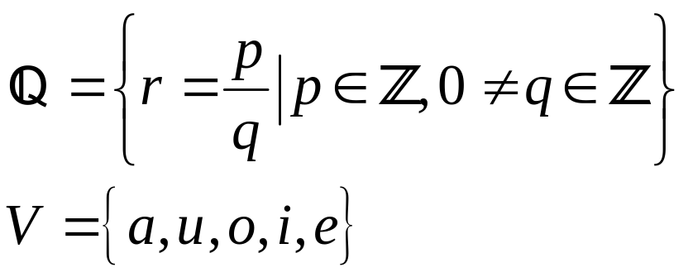
2.1- Sets
An unordered collection of objects
The objects in a set are called the elements, or members. A set is said to contain its elements.
Some important sets in discrete mathematics
  N = { 0,1,2,3,4,… }
  Z = { … , -2,-1,0,1,2,…} Z⁺ = {0,1,2,…}
  R: the set of real numbers
G. Cantor

Slide 4

Sets…
Definitions:
Finite set: Set has n elements, n is a nonnegative integer
A set is an infinite set if it is not finite
Cardinality of a set |S|: Number of elements of S
 : empty set (null set), the set with no element
Two sets are equal ←→ they have the same elements
A = B if and only if ∀x (x∈A ↔ x∈ B)
A⊆ B: the set A is a subset of the set B
A ⊆ B if and only if ∀x (x∈A → x∈ B)
A ⊂ B: A is a proper subset of B
A ⊂ B if and only if (A ⊆ B) ^ (A ≠ B)
Venn diagram shows that A is a subset of B

Slide 5
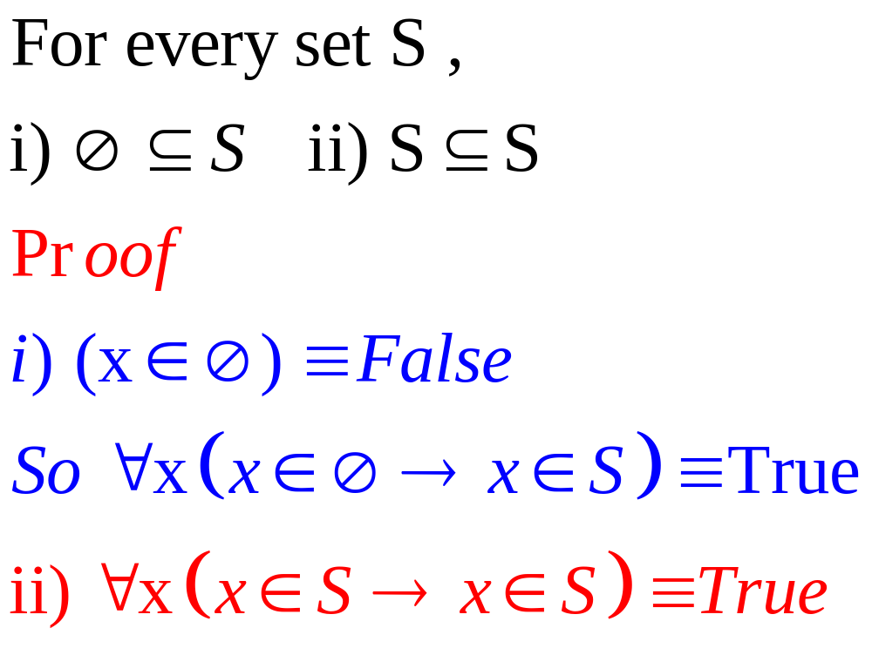
Theorem 1

Slide 6
Power Sets
Given a set S, power set P(S) of S is a set of all subsets of the set S.
S= { 1,2,3}
P(S)= {Ø,
{1}, {2},{3},
{1,2}, {1,3},{2,3},
{1,2,3}}

Slide 7
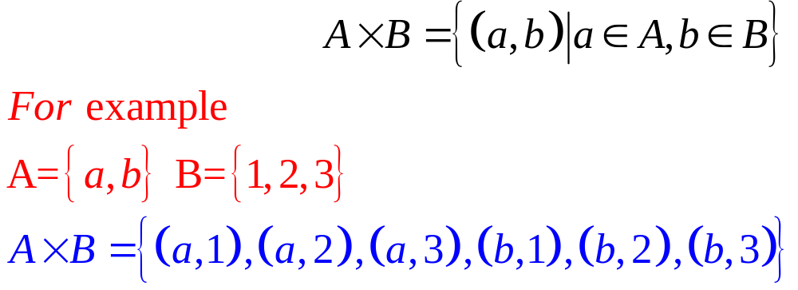
Cartesian Products
The ordered n-tuple (a₁,a₂,…,a_{n}) is the ordered collection that has a₁ as its first element, a₂ as its second element, …, and a_{n} as its n^{th} element.
Let A and B be sets. The Cartesian product of A and B, denoted by AxB,

Slide 8
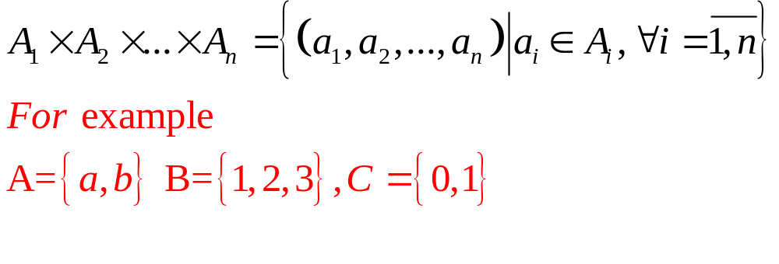
Cartesian Products…
The Cartesian product of A₁,A₂,…,A_{n} , denoted A₁xA₂x…xA_{n}, is the set of ordered n-tuples (a₁,a₂,…,a_{n}),
AxBxC= {(a,1,0),(a,1,1),(a,2,0),(a,2,1),(a,3,0),(a,3,1),
(b,1,0),(b,1,1),(b,2,0),(b,2,1),(b,3,0),(b,3,1) }

Slide 9
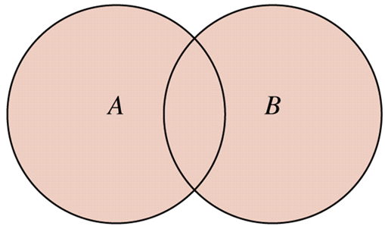
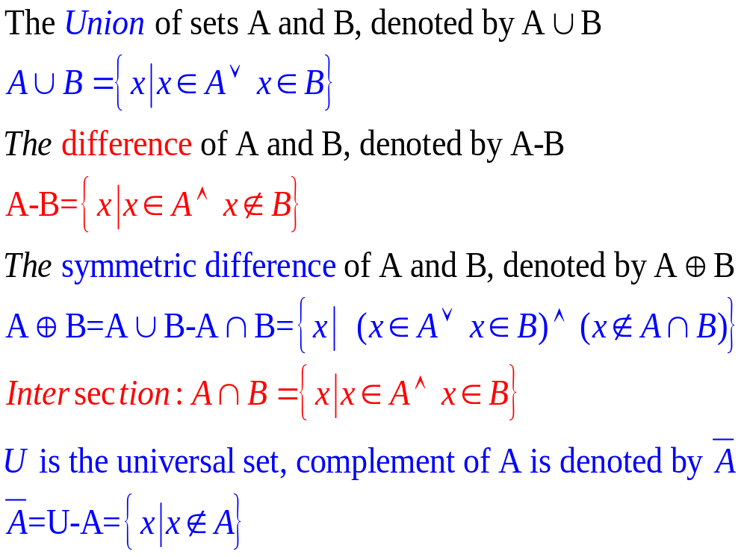
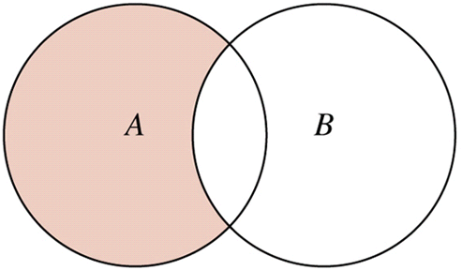

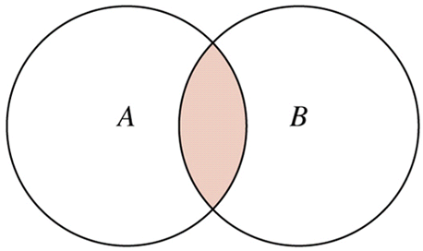
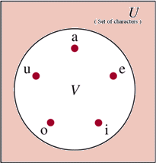
2.2- Set Operations

Slide 10

Set Identities
Identity – See proofs : pages 125, 126 | Name
A ∪ = A A∩ U = A | Identity laws - Luật đồng nhất
A ∪U= U A ∩ =  | Domination laws - Luật thống trị
A ∪A=A A∩A=A | Idempotent laws – Luật bất biến
 | Complementation law – Luật bù đôi
A∪B = B ∪ A A∩B=B ∩A | Commutative laws – Luật giao hoán
A∪ (B∪ C)= (A ∪B) ∪ C A∩ (B ∩ C)= (A ∩B) ∩ C | Associative laws – Luật kết hợp
A∩ (B ∪ C) = (A ∩B) ∪(A ∩ C) A ∪ (B ∩C) = (A ∪ B) ∩(A ∪ C) | Distributive laws Luật phân phối
A ∪ B = A ∩ B A ∩B = A ∪ B | De Morgan laws
A ∪ (A ∩B) = A A ∩ (A∪B) = A | Absorption – Luật hấp phụ
A ∪ A = U A ∩‾A =  | Complement laws – Luật bù

Slide 11
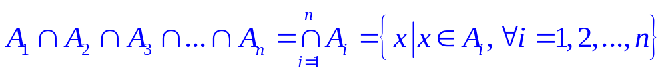
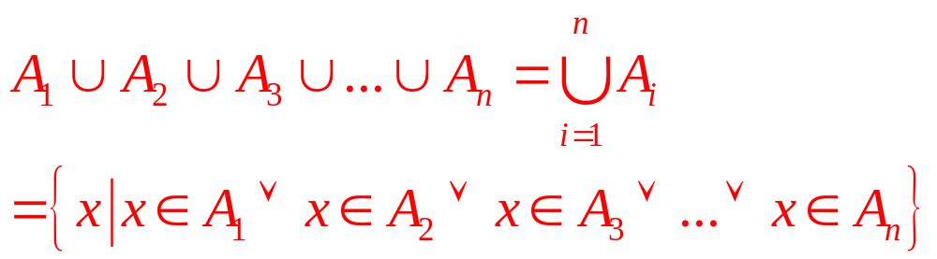
Generalized Unions and Intersections
Computer Representation of Sets
Use bit string U={1,2,3,4,5,6,7,8,9,10}
A= {1,3,5,7,9 } ➔ A = “1010101010”
B= { 1,8,9} ➔ B = “1000000110”

Slide 12
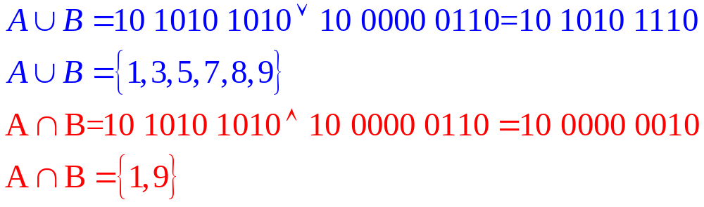
Computer Representation of Sets
A = “1010101010”
B = “1000000110”

Slide 13
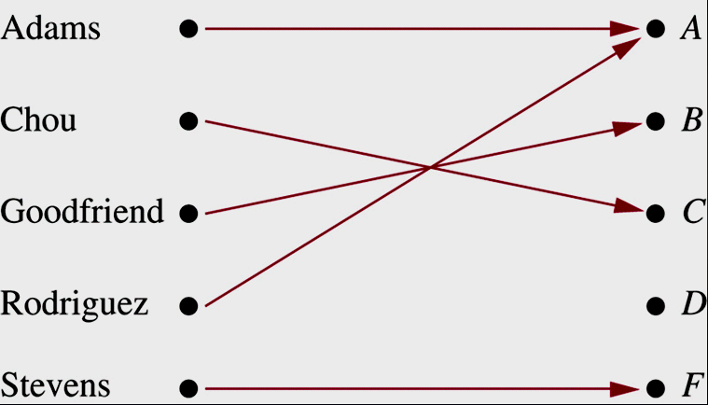
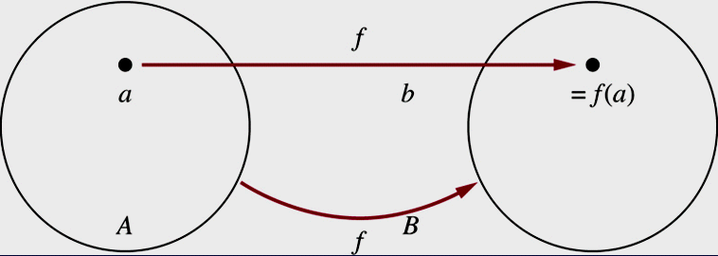
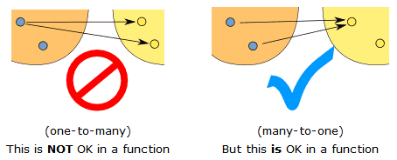
2.3- Functions/Mapping/
Transformation - Ánh Xạ
f: A → B function f from A to B (or function f maps A to B)
A: domain of f
B: codomain of f

Slide 14
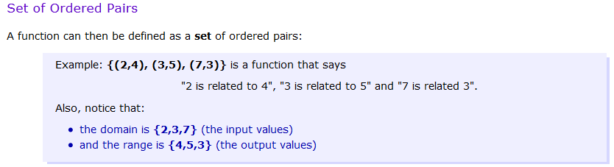
Functions as sets of ordered pairs

Slide 15
Functions/Mappings/Transformations…
What are functions?
f: → ○ : f(x) = x² + 2
f: → ○ : f(x) = 1/(x-1)² + 5x
f: ○→ ○ : f(x) = (2x+5)/7
f: → ○ : f(x) = (2x+5)²/(7-2x)

Slide 16
Some Important Functions
See Figure 10 – Page 143
Floor function
f: ○ → such that f(x)= ⎣x⎦ = largest integer that less than or equal to x (số nguyên lớn nhất chưa vượt qua x), ⎣x⎦ x
Ceiling function
f: ○ → such that f(x)= ⎡x⎤ = smallest integer that greater than or equal to x ( số nguyên bé nhất x chưa vượt qua), x ⎡x⎤

Slide 17
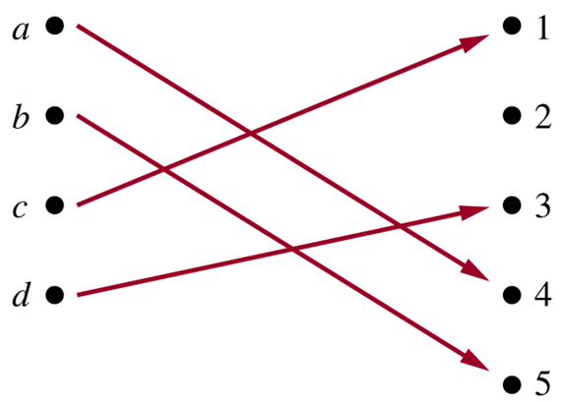
One-to-One/ Injective functions ( đơn ánh)
Function f is one-to-one (or injective) if and only if
a  b → f(a)  f(b)
for all a and b in the domain of f.
f :  → , f(x) = x²
f is not one-to-one
(we have f(-1) = f(1))

Slide 18
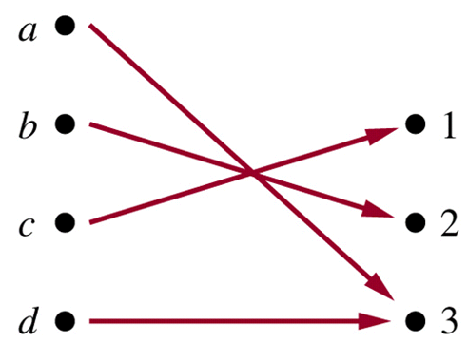
Onto Functions – Ánh xạ trên
( toàn ánh)
A function f from A to B is called onto, or surjective, iff
for every element b in B there is an element a in A with f(a)=b.
f:  → , f(m) =m-1
f is onto because ∀y∈ , y=f(m)=m-1, where m=y+1

Slide 19
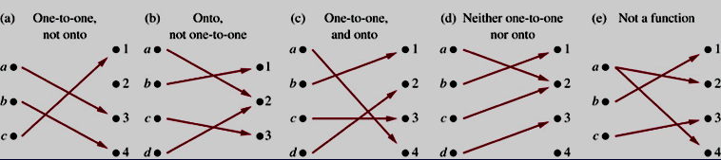
One-to-one Correspodent / Bijective
Functions ( song ánh)
Function f is a one-to-one corespondence or a bijection if it is both one-to-one and onto.
f: {A,B,…,Z} →{65,66,…,90} is a bijection

Slide 20
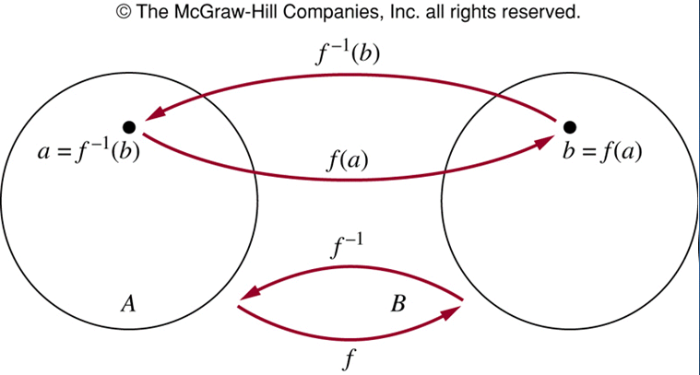
Inverse Functions
Let f is a bijection from A to B. The inverse function, denoted by f⁻¹, of f is the function that assigns to an element b belonging to B the unique element a in A such that f(a)=b. Hence f⁻¹(b)=a when f(a)=b.

Slide 21
Inverse Functions…
f:→ such that f(x)=x+1
Is f invertible? And if it is, what is its inverse?
Step 1: Show that f is onto
f(y-1)=y for all y
➔ f is onto
Step 2: Show that f is one-to-one
f(a)=a+1= f(b)=b+1 ➔ a=b ➔ f is one-to-one
f is bijection ➔ f is invertible
Step 3: Find inverse function
f(x)= y=x+1 ➔x=f⁻¹(y)
x=y-1 ➔ f⁻¹(y)=y-1

Slide 22
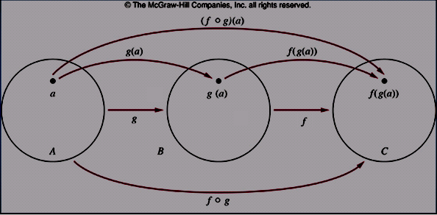
Composition of Functions – Ánh xạ hợp
Let g:A → B, f: B → C
The composition of f and g, denoted by f□g, is defined by: (f□g)(x)= f(g(x))
Example:
f:  →, f(x)=x+1
g:→, g(x)= x²
(f□g)(x)= f(g(x))= f(x²) = x²+1
(g□f)(x) = g(f(x)) = g(x+1)= (x+1)²

Slide 23
2.4- Sequences
Sequence : a₁, a₂, a₃,…, a_{n},…
  Ex: 1,3,5,8 : Finite sequence
  Ex: 1, 1, 2, 3, 5, 8, 13,… : Infinite sequence
A sequence is a function from a subset of integers to a set S.
a_{n} : image of the integer n
a_{i} : a term of the sequence
{a_{n}= 1/n}: ₊→ ○ ➔ 1, 1/2, 1/3, 1/4, …

Slide 24
Sequences…
Geometric progression (cấp số nhân)
f(n) = ar^{n} ➔ a, ar, ar², ar³, …, ar^{n}
Arithmetic progression (cấp số cộng)
f(n) = a + nd ➔ a, a+d, a+ 2d, … , a+nd
a: initial term,
r: common ratio, a real number
d: common difference, real number
Do your self
b_{n}= (-1)^{n} , n>=0 c_{n}= 2(5)^{n} , n>=0
t_{n}= 7-3n, n>=0 a_{n}= -1 + 4n, n>=0

Slide 25
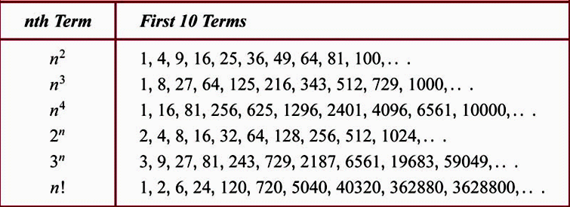
Some Useful Sequences

Slide 26
Hints for deducing a possible formula for the terms of a sequence.
1. Are there runs of same value? 1 2 2 3 3 3 4 4 4 4……
2. Are terms obtained from previous term by adding/ multiplying by a particular amount?
1 5 9 13 17 … 2 6 18 54 ….
4. Are terms obtained by combining previous terms in a certain way? 1 1 2 3 5 8 13 …
5. Are they cycles among terms
Ex:
{a_{n}} 1 7 25 79 241 727 ….
6 18 54 162 486 ➔ close to 3 ➔ {3^{n}}
{3^{n}} = 3 9 27 81 243 729 …
➔ {a_{n}} = {3^{n} -2}

Slide 27
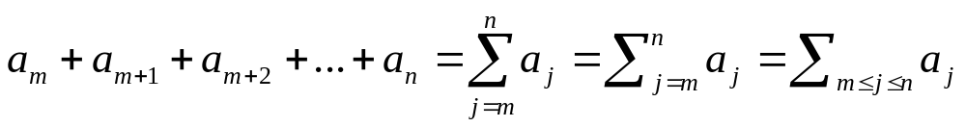
Summations
a : Sequence
j : Index of summation
m: Lower limit
n : Upper limit
// 1 + 2 +3+4+…+n
long sum1 ( int n) // n additions
{ long S=0;
for (int i=1; i<=n; i++) S+= i;
return S;
}
// 1 addition, 1 multiplication, 1 division
long sum2 (int n)
{ return ((long)n) * (n+1)/2;
}
See examples 10, 11. Page 154

Slide 28
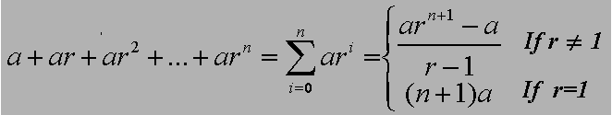
Summations….
Theorem 1- (Summation of geometric series)
See the proofs in page 155

Slide 29
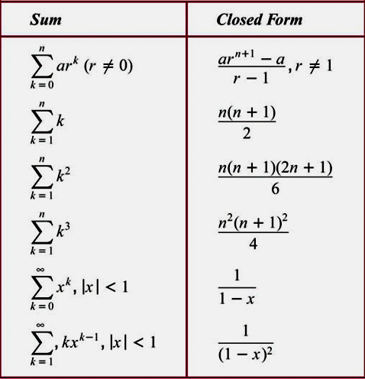
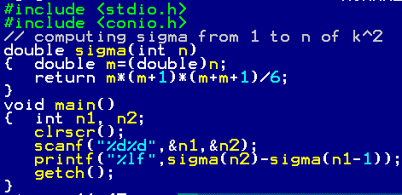
Some Useful Summation Formulae
See example 15, page 157

Slide 30
Cardinality – Lực Lượng
Cardinality = number of elements in a set.
The sets A and B have the same cardinality if and only if there is a one-to-one correspondence from A to B
A set that is either finite or has the same cardinality as the set of positive integers is called countable.
A set that is not countable is called uncountable.
When a infinite set S is countable , we denote the cardinality of S is |S|= א₀ (aleph null)
For example, | א₀ because  is countable and infinite but ○ is uncountable and infinite, and we say |○^{ א0}

Slide 31
Examples p.159, 160
sets | countable | uncountable | cardinality
{a, b, …, z}, {x| x⁵ -3x² – 11 = 0}, … |  |  | < 
{0, 2, 4, …, } |  |  | א₀
N, Z⁺, Z, Q, ZZ, … |  |  | א₀
{x| 0 < x < 1}, R,… | ✗ | ✓ | 2^{א0}

Slide 32
Summary
Sets
Set operations
Functions
Sequences
Summations

Slide 33
Thanks

